Slide 1
WALKERS TOP TEN EXAM TIPS

Slide 2
1

Slide 3
Read all the instructions carefully
Don’t answer the wrong or too many questions by mistake
Don’t answer too few questions because you run out of time
Answering a question even roughly will give you more marks than not answering it at all and more marks than perfecting the previous answer.

Slide 4
2

Slide 5
Answer the question asked
Not the question you think you were asked
Not the question you wish you had been asked
Pay attention to the question rather than writing everything you know about.....

Slide 6
3

Slide 7
Take your time
Give yourself planning time
You don’t have to spend the whole time writing. You can spend time thinking
Good exam answers are not always long answers

Slide 8
4

Slide 9
You can’t memorise everything
Any exam is not a memory test, it is asking for your understanding of what you have studied
It is also your opportunity to stand back, reflect on and connect the material you have covered over the year
You will not fail if you don’t remember a particular reference
But in language exams memory is more important....
Once in the exam concentrate on what you know not what you don’t know and be creative if you need to

Slide 10
5

Slide 11
Practise previous exam questions
Look over previous exam papers to identify patterns in questions
You can see how general or specific questions are likely to be
You can either practise writing answers to time or practise planning answers (perhaps a more efficient use of time)
Your teacher may be willing to look at your draft plan

Slide 12
6

Slide 13
Don’t panic if you think you’ve gone blank
Take your time
Keep breathing
Brainstorm or just write random words/doodle rather than sit frozen

Slide 14
7

Slide 15
Learn to use your breath
Using your breath can soothe and calm you
It is impossible to be relaxed and anxious at the same time
Focus on breathing out rather than breathing in, breathing out smoothly, slowly but without strain
Feel your breath flow through your body from the crown of your head to your feet and through the floor so you ground yourself

Slide 16
8

Slide 17
Take care of yourself
Make sure you get enough sleep
Keep a balanced diet
Keep up regular exercise, even simple walking

Slide 18
9

Slide 19
Don’t talk about the exam before or after
Talking to others about the exam immediately before isn’t likely to be helpful. Others’ anxiety can be infectious. Everyone prepares differently
Talking about the exam afterwards is also probably unhelpful. There can be many different approaches to the same question. Once your paper is handed in, let it go

Slide 20
10

Slide 21
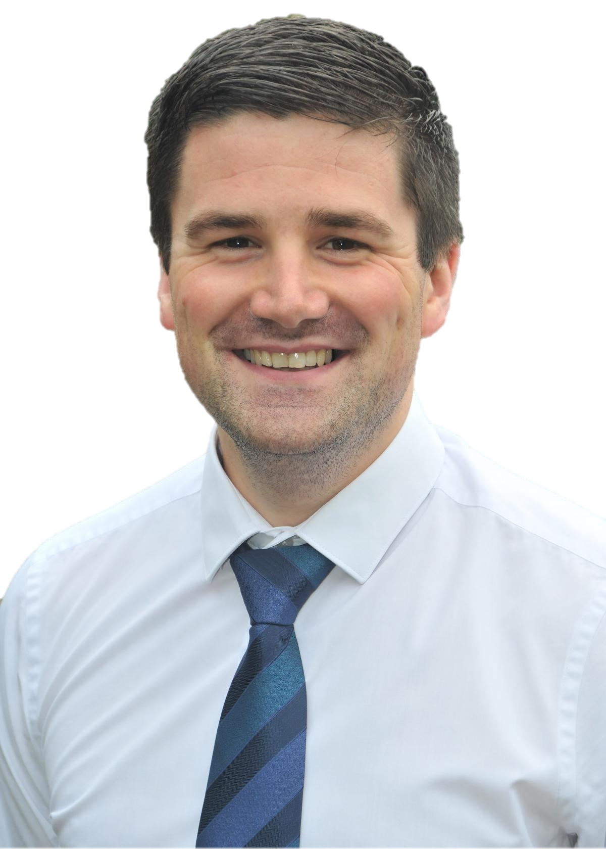
Give yourself a treat after the exam
Once the exam is over give yourself time to do something you enjoy as a reward
Let go of the exam – enjoy the present moment rather than dwelling on the past

